Slide 1
WEL-COME TO
SHREE CHINTAMANI GROUP OF COMPANIES
At:-Gat No. 465, Badhalwadi Road ,
Post:-Navlakh Umbre,
Next to Talegaon MIDC, Near General Motors,
Tal:-Maval,Dist:-Pune
WE ARE MOTIVATED BY DESIRE TO ACHIEVE

Slide 2
.
.
Mile Stone
SHREE CHINTAMANI GROUP OF COMPANIES
Shree Chintamani Packaging Industries – 2009
An ISO 9001:2015 Certified Company
(All type of corrugated boxes and AAA heavy duty Boxes)
Shree Chintamani Autocomp and Engineering Products Pvt. Ltd. – 2012
An IATF 16949:2016 Certified company
(Aluminum Parts with precision machining parts for Two wheeler and Four
Wheeler and home Appliances)
RSH INDUSTRY 2021
An ISO 9001:2015 Certified Company
(PET/PP/HIPS/Sheet Manufacturing)

Slide 3
.
Introduction
We would like to introduce our selves as a leading manufacture of
Precision machined, Pressure die casting components. We follow various Quality System Procedures to achieve excellence in manufacturing .
The company has evolved into a group of companies. The Company is into manufacturing & supply of Precision machined /Pressure die casting components for Automobile parts, at different locations in
India.
An IATF 16949 :2016 Certified company

Slide 4
.
Business Policy
We Shall always maintain to be No.1 supplier of
Aluminium High Pressure Die Casting and Forged
Machined parts in terms of quality & customer satisfaction.
We are committed to continually improve the
effectiveness of our business management system
through QMS.
An IATF 16949 :2016 Certified company

Slide 5
ORGANIZATION STRUCTURE
MANAGING DIRECTOR
CEO
PLANT HEAD
ACCOUNT HEAD
PURCHAGE MANAGER
HR
MANAGER
ASST.ACCOUNT MANAGER
PRODUCTION MANAGER DIE CASTING
PRODUCTION MANAGER
MACHINING
MAINTAINANCE ENGINEER
QUALITY ENGINEER
STORE MANAGER
LINE LEADER
LINE LEADER
QUALITY INSPECTOR
STORE KEEPER

Slide 6
.
MILESTONES
2020 -21 PDC TBC 180T 1 No.
2018 VMC BFW Make & 2 CNC
2015 SPM & Drill Tap M/cs (11 Nos)
2014 Shot blasting m/c (3 Nos) ACE Turning center (2 Nos)
2013 Added HMT 180T PDC M/C
2011Started with TBC 180T PDC M/C& 2 CNC

Slide 7
.
CERTIFICATES

Slide 8
.
Shree Chintamani Autocomp
Machinery List
SL. NO. | DESCRIPTION | MAKE | QTY. NOS. | YEAR OF MFGR.
1 | 180 TONS FULLY AUTO DIE-CASTING MACHINE | TBC ( TAIWAN) | 2 | 2011 / 2021
2 | 180 TONS SEMI-AUTO DIE-CASTING MACHINE | TBC ( TAIWAN ) | 1 | 2018
3 | CNC TURNING CENTRES DIA 165 HOLDING | ACE | 5 | 2014 / 2018
4 | CNC TURNING CENTRES DIA 210 HOLDING | ACE | 2 | 2013
5 | VMC 4th Axis with U cam 500x400x400 | BFW | 1 | 2018
6 | SPM- GANG TYPE DRILLING / TAPPING M/CS | TAIWAN ) | 5 | 2015
7 | ROTARY BARREL TYPE SHOT BLASTING MACHINE | SURFEX | 3 | 2014/2016
8 | 1/4" DRIILING MACHINES | SUPER | 2 | 2015
9 | 1/4" DRILLING MACHINE | POWERMATIC | 2 | 2015
10 | 1/2" DRILLING MACHINE | TAPEX | 1 | 2014
11 | 1/2" DRILLING MACHINE | KMP | 1 | 2014
We are motivated by desire to ''Achieve''

Slide 9
.
Shree Chintamani Autocomp
Machinery List
SL. NO. | DESCRIPTION | MAKE | QTY. NOS. | YEAR OF MFGR.
12 | 6 MM TAPPING MACHINES | POWERMATIC | 4 | 2015
13 | HARDNESS TESTING MACHINE | SUPERFINE | 1 | 2014
14 | TRIMMING PRESS 1 TON | IN-SOURCE | 2 | 2015
15 | TRIMMING PRESS 1\4 TON | SHARP | 2 | 2015
16 | SCREW TYPE COMPRESSOR | CHICAG0 | 1 | 2012
17 | RECIPROCATING COMPRESSOR | ELGI | 1 | 2014
18 | RECIPROCATING COMPRESSOR | JYOTI | 1 | 2011
19 | BUSH PRESSING MACHINE | LG ENGG | 1 | 2014
20 | LINISHING MACHINE 50X2000 | BALAJI | 2 | 2013
21 | BELT SANDER MACHINE 150X1200 | CHANDAN | 3 | 2015
22 | PRINTING & EMBOSSING MACHINE | MEDITECH | 2 | 2016
23 | LATHE MACHINE | PRATEEK | 1 | 2016
We are motivated by desire to ''Achieve''

Slide 10
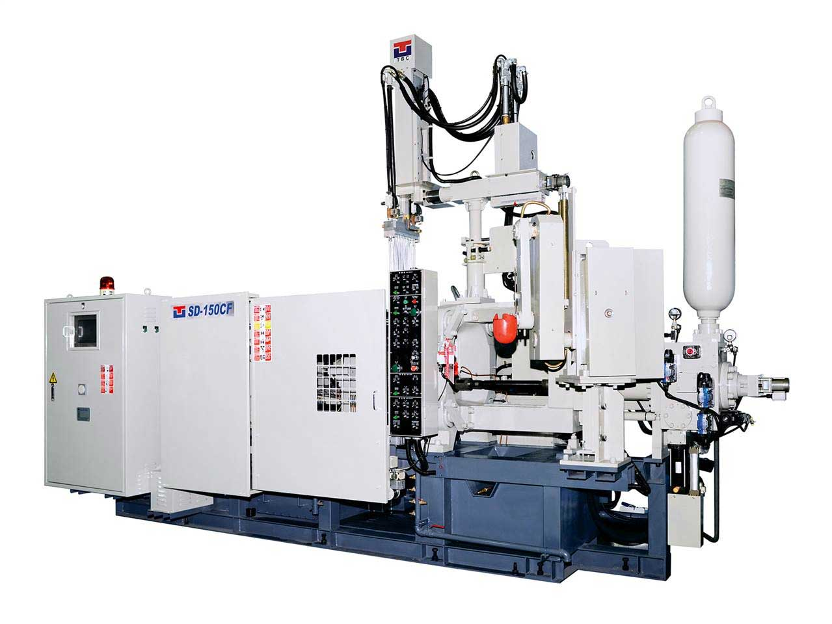
.
Facilities at Chintamani Autocomp
1- TBC ( Auto) :- 180 T ( 3 nos)
2- CNC :- 7 Nos.
3- VMC :- 1 No.
4- SPM Drill Tap :- 5 Nos.
5- Shot Blasting :- 3 Nos.
Conventional Drill :- 10 Nos.
Conventional Tap :- 6 Nos.

Slide 11
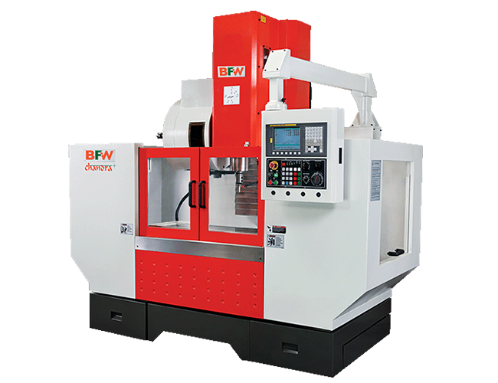
.
VMC Machine
VMC Machine BFW Make WITH 4th AXIS U CAM 500X400X400

Slide 12
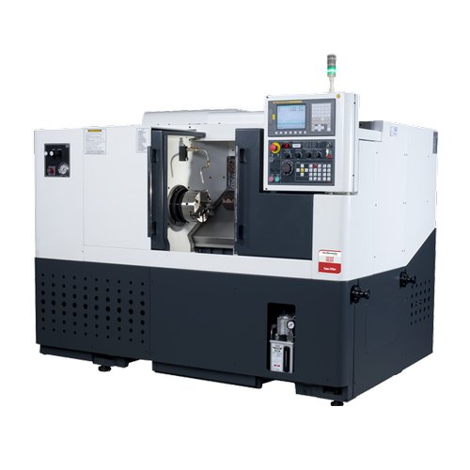
.
cnC Machine
CNC Machine ACE Make TURNING DIA 165 -210 MM

Slide 13
.
In-house Facilities
1.Belt Grinder
2. Printing Machine
3.Fettling Operation
4.Trimming
5.Shot Blasting M/C
6. Embossing Machine

Slide 14
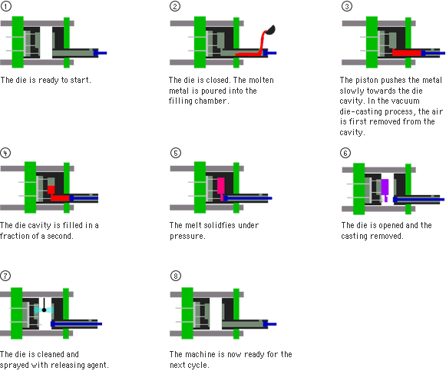
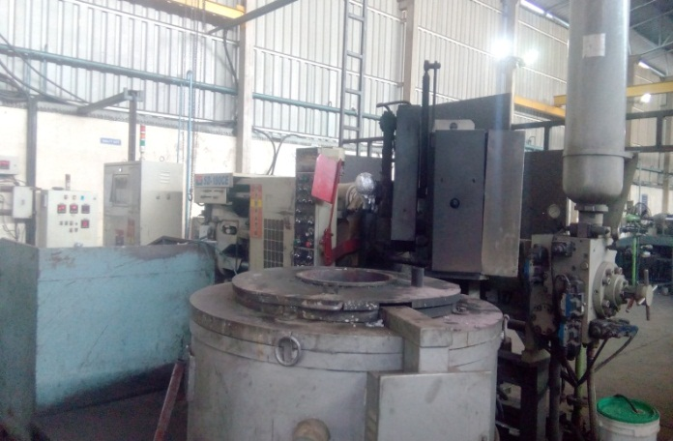
.
Pressure Die Casting: Advanced Pressure die casting technology to handle all
kind of auto parts
Specification | Minimum | Maximum
gm | 09 gms | 800 gms
We are motivated by desire to ''Achieve''

Slide 15
.
Pressure Die Casting: Installed PDC Capacity 100 Tons
Capacity
TBC-1 | 180 Ton
TBC-2 | 180 Ton
TBC-3 | 180 Ton
UPCOMING
400T
We are motivated by desire to ''Achieve''

Slide 16
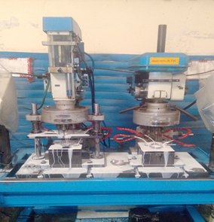
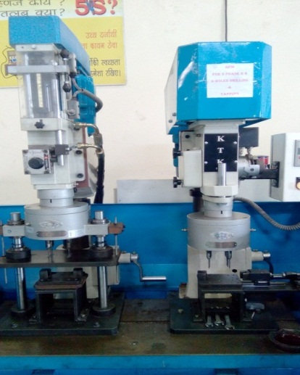
.
SPM Facility: Installed SPM Capacity
Precision Pitch Controlled SPMs, KTK Taiwan Make
We are motivated by desire to ''Achieve''

Slide 17
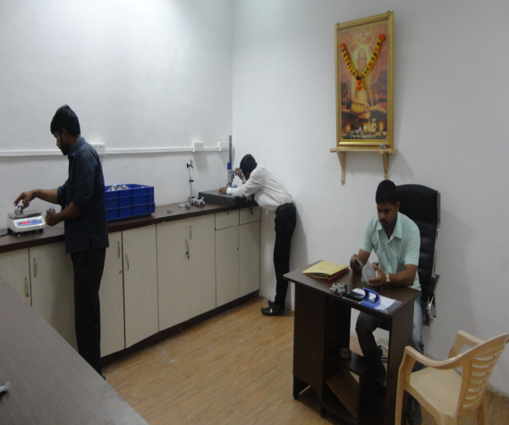
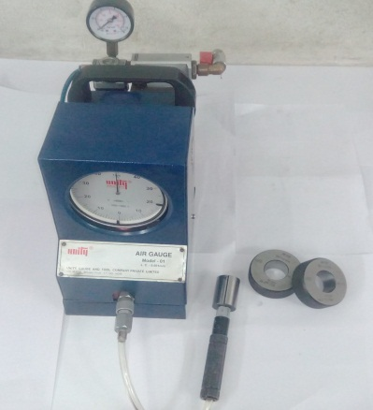
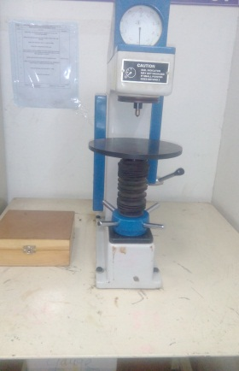
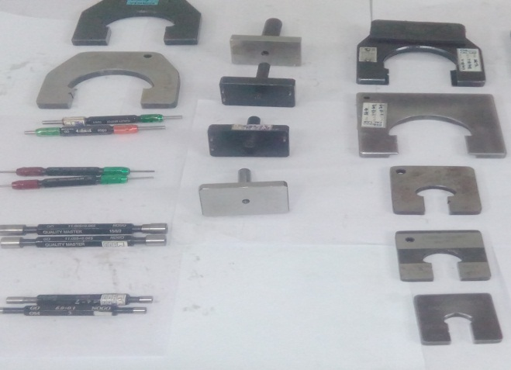
.
QC ROOM
Air Plug Gauges With Setting Rings
Hardness Tester
All Measuring Gauges
Depth Micrometer
Vernier/Micrometer
Height Gauge
Bore Gauge

Slide 18
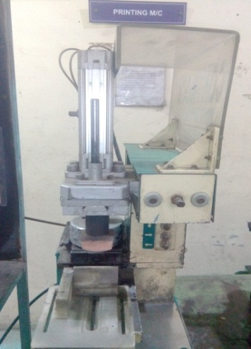
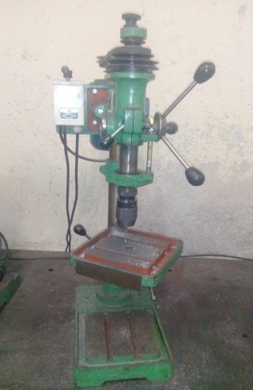
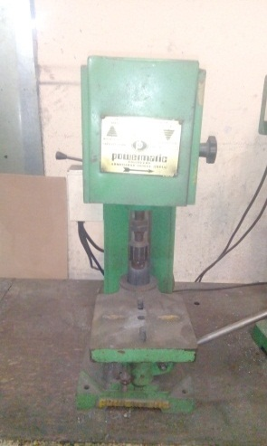
.
Shot Blasting/Printing/Drilling /Tapping Facility
Shot Blasting M/C
3 Nos.
Printing M/C
1 No.
½’’ Drilling M/C
16 Nos
6 MM Tapping M/C
12 Nos.
We are motivated by desire to ''Achieve''

Slide 19
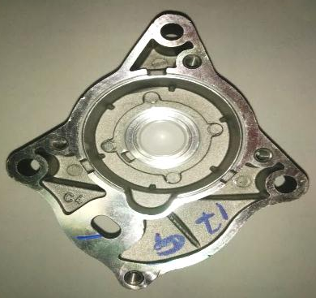
.
Product View
KINETIC TAIGENE (I) PVT.LTD.
STARTER MOTOR SUPPORTING BRACKETS
CENTRE BRACKET
PGR VESPA BRACKET
APEPAX FRONT BRACKET
APEPAX REAR BRACKET
GEAR CASE
SM5 AATA BRACKET
Shree Chintamani Autocomp & Engineering Products Pvt.Ltd.

Slide 20
.
Product View
STAR ENGINEERS (I) PVT.LTD.
REGULATORS
AF REGULATOR
KTM REGULATOR
FLICKER RR
3 PHASE RR
DC-DC REGULATOR
Shree Chintamani Autocomp & Engineering Products Pvt.Ltd.

Slide 21
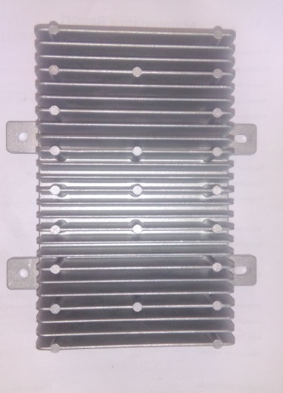
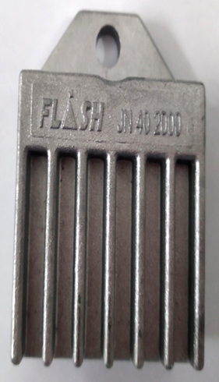
.
Product View
FLASH ELECTRONICS (I) PVT.LTD.
REGULATORS
MACHINED HUB
JN HOUSING
BF REGULATOR
AL HOUSING
Shree Chintamani Autocomp & Engineering Products Pvt.Ltd.

Slide 22
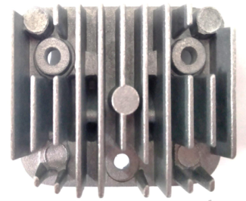
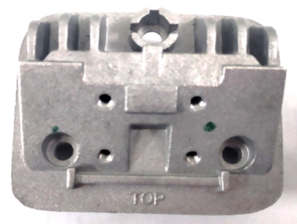
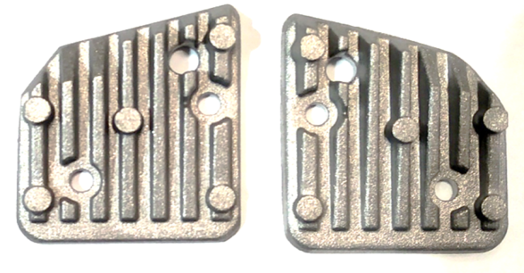
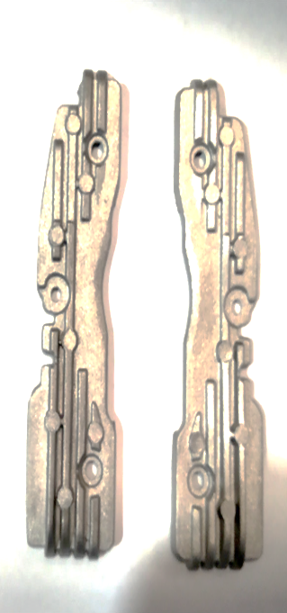
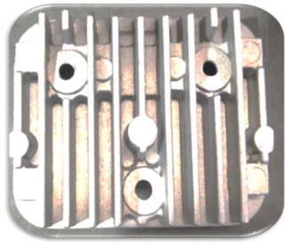
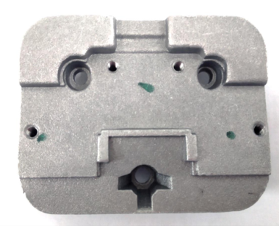
.
Product View
VARROC ENGINEERING (I) PVT.LTD.
HEAT SINKS
TOP HEAT SINK
BOTTOM HEAT SINK
HIGH BEAM HEAT SINK
Shree Chintamani Autocomp & Engineering Products Pvt.Ltd.

Slide 23
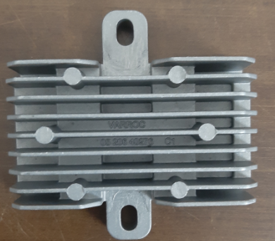
.
Product View
VARROC ENGINEERING LTD.
P1RR CASE
K17 RR
RR UNIT- 3 PHASE RR
We are motivated by desire to ''Achieve''

Slide 24
.
Product View
DELLORTO INDIA PVT.LTD.
SUPPORTING BRACKET
Shree Chintamani Autocomp & Engineering Products Pvt.Ltd.

Slide 25
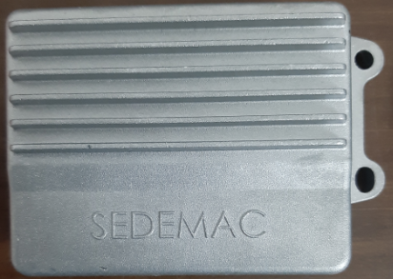
.
Product View
SEDEMAC MECHATRONICS (I) PVT.LTD.
MOPED
U368
N360C
We are motivated by desire to ''Achieve''

Slide 26
.
Our Valuable Customers
We are motivated by desire to ''Achieve''

Slide 27
.
Positive Approach
We are motivated by desire to ''Achieve''

